Slide 1
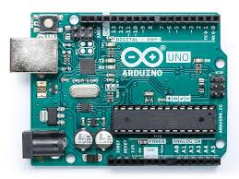

Computer
Slave 1 (1)
Tracked Cart
Controls the location of the tracked cart
Interfaces with the ultrasonic sensor
Slave 2 (2)
Dispenser
Controls the stepper motors of the dispenser
Processing
GUI (sliders/buttons)
interfaces with Arduino via serial communication
I2C Communication Bus
USB
Slave 3 (3)
Robotic Arm
Stepper motors
Servos
Limit switches
Slave 4 (4)
Mixer/Former
Controls the motors of the mixer and former
Master (0)
Interprets and directs commands

